Slide 1
The Agile-Scrum Approach
Corey Pennebaker
04/15/2022
Cs250

Slide 2

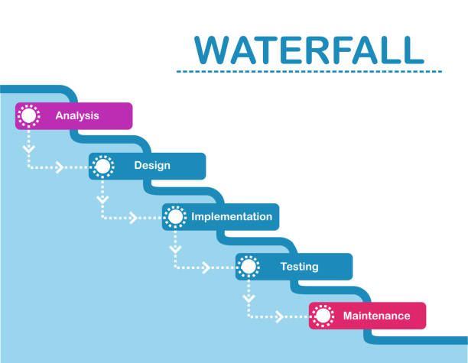
WaterFall approach
To understand agile, it's important to look at a different mythology in the waterfall method
This approach implements the bulk of its planning during the beginning of the project
It was designed to eliminate costs further down the line of development
But in doing so this generates greater cost to alter projects due to unforeseen problems

Slide 3
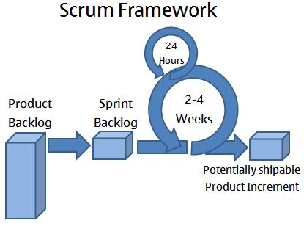
Scrum
In a scrum project, pieces of the project are developed incrementally accroding to when items for a feature are due
This makes changing the actual workings of the project to meet changing demands in the project
And unlike in Waterfall, communication is constantly happening between customer, owner and developers

Slide 4
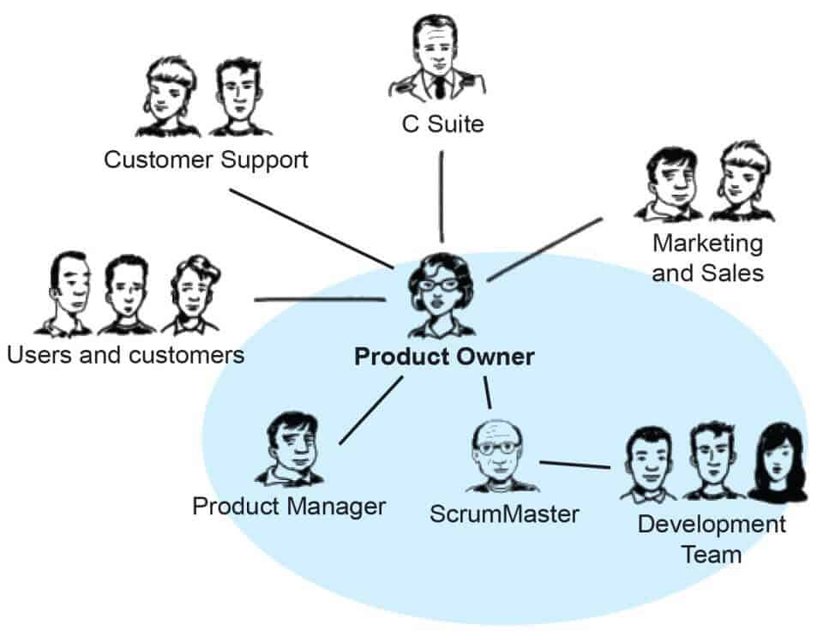
Product Owner
Communicate with customers and produce user stories
Manage product backlog and order work accordingly
Regular face to face time with customers/users
Has Face to Face meetings creating user stories for backlog

Slide 5

Tester
Provides continuous testing rather than just testing at the end
Ensures Quality in team product
Focus on user stories/customer needs rather than product specifications
Creates test to provide constant updates in the program when new requirements are needed
Works from beginning of project as appose to just the end like in waterfall methology

Slide 6

Scrum master
Facilitate teams daily standup and other team regular team meetings
Helps development team with deal with obstacles that arise during development
Works towards working as more of a mentor that a leader to their team

Slide 7

Developer
Attends all daily stand ups on time and sprint planning communicates needs clearly
Communicates with rest of the team to ensure all features are being developed according to specs
Detailed oriented and focused on user needs
Develops product features for final program

Slide 8
AGILE-scrum vs. Waterfall
When deciding which approach is right for a project it’s important to consider the needs of the project. The waterfall method is best suited for project like automotive factory. Where you supply and demands needs will be predetermined and production should flow one direction.
The agile-scrum approach is far better suited for programming or any user-based service. The approach gives far more flexible and room to adapt to new situations. And the entire team from user to developer are in constant contact with each other, so the real needs of the project are addressed and not a bunch of frills and extra features the user has no need for.

